Slide 1
Chapter 5: Things and Connections
IOT CƠ BẢN
502068

Slide 2
Ghi chú về bản quyền
Toàn bộ nội dung bài giảng là của CISCO, sinh viên có quyền tải về, lưu trữ, in ấn, tham khảo cho mục đích học tập. Sinh viên không được phát hành lại hay thay đổi nội dung slide nếu chưa có sự đồng ý của chủ sở hữu.
Phần ghi chú ở cuối slide (nếu có) là do các thầy cô ghi chú lại trong quá trình giảng dạy.

Slide 3
Chapter 1: Things and Connections
IoT Fundamentals
Connecting Things 2.01
Notes:
Cisco Networking Academy Program
IoT Fundamentals Connecting Things 2.01
Chapter 1: Things and Connections

Slide 4
Chapter 1 - Sections & Objectives
1.1 What are Things?
Analyze the things that make up the IoT.
1.2 What are Connections?
Explain how things connect to other things and to the IoT.
1.3 Chapter Summary
Notes:
3

Slide 5
1.1 What are Things?
Notes:
Cisco Networking Academy Program
IoT Fundamentals Connecting Things 2.01
Chapter 1: Things and Connections
Section 1.1 What are Things?

Slide 6

What are Things? 1.1.1 The Internet of Things
The Presence of IoT in Today's World
The IoT is all around us.
The IoT helps individuals to improve quality of life.
The IoT also helps industries to become more efficient.
Cisco IoT Solutions
The rapid IoT growth has introduced new challenges.
Cisco IoT System reduces the complexities of digitization.
Six Pillars of the Cisco IoT System are:
Network Connectivity
Fog Computing
Cybersecurity and Physical Security
Data Analytics
Management and Automation
Application Enablement Platform
Notes:
1.1 - What are Things?
1.1.1 – The Internet of Things

Slide 7
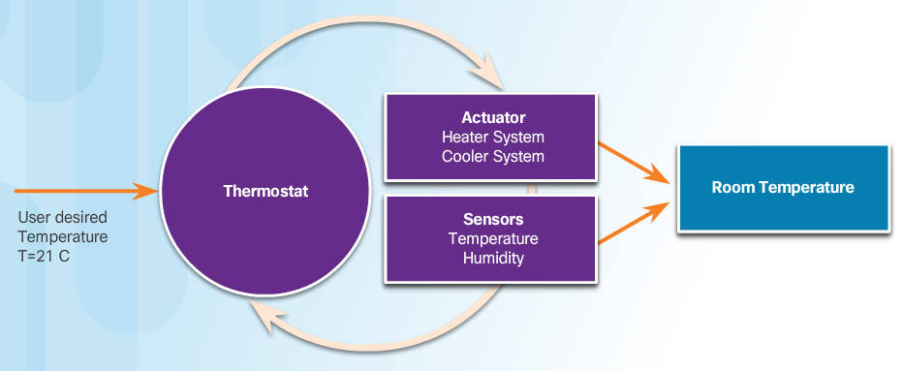
What are Things? 1.1.2 Building Blocks of an IoT System
Overview of a Controlled System
Feedback loops are used to provide real-time information to its controller based on current behavior.
In a closed loop, feedback is continuously being received by the controller from its sensors.
The controller continuously analyzes and processes information, and use actuators to modify conditions.
Sensors
A sensor is a device that can be used to measure a physical property by detecting some type of information from the physical world.
A sensor may be connected to a controller either directly or remotely.
Notes:
1.1 - What are Things?
1.1.2 – Building Blocks of an IoT System

Slide 8
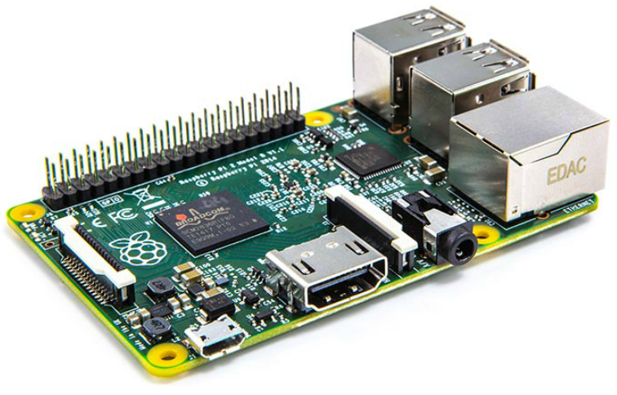
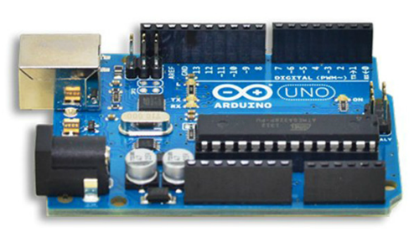
What are Things? Building Blocks of an IoT System (Cont.)
Actuators
An actuator is a basic motor that can be used to control a system.
Can be hydraulic, electric or pneumatic.
can be responsible for transforming an electrical signal into physical output.
Controllers
Responsible for collecting data from sensors and providing network connectivity.
Controllers may have the ability to make immediate decisions.
May also send data to remote and more powerful computer for analysis.
IoT Process Flow
A simple IoT system include sensors connecting, through a wireless or wired connection, to actuators or controllers.
Some devices can have more than one function.
Notes:
1.1 - What are Things?
1.1.2 – Building Blocks of an IoT System (Cont.)

Slide 9
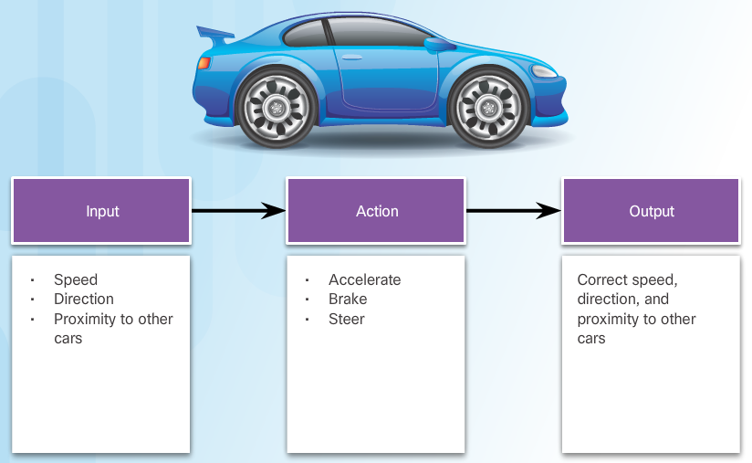
What are Things? 1.1.3 Processes in Controlled Systems
Processes
A process is a series of steps or actions taken to achieve a desired result by the consumer of the process.
Feedback
Feedback is when the output of a process affects the input.
Feedback is often referred to as a feedback loop.
Feedback loops can be positive or negative.
Control Systems
Includes a controller that uses inputs and outputs to manage and regulate the behavior of the system in an attempt to achieve a desired state.
The controlled portion of the system is often called the plant.
Choosing the adjustments to apply to a plant to achieve a desired output is called control theory.
Control theory is applied to many systems, including driving a car.
Notes:
1.1 - What are Things?
1.1.3 – Processes in Controlled Systems

Slide 10
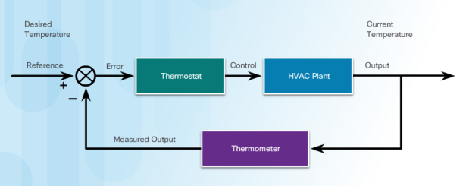
What are Things? Processes in Controlled Systems (Cont.)
Open-Loop Control Systems
Open-loop control systems do not use feedback.
The plant performs a predetermined action without any verification of the desired results.
Open-loop control systems are often used for simple processes.
Closed-Loop Control Systems
A closed-loop control system uses feedback to determine whether the collected output is the desired output.
The result is then fed back into a controller to adjust the plant for the next iteration of output, and the process repeats.
Notes:
1.1 - What are Things?
1.1.3 – Processes in Controlled Systems (Cont.)

Slide 11
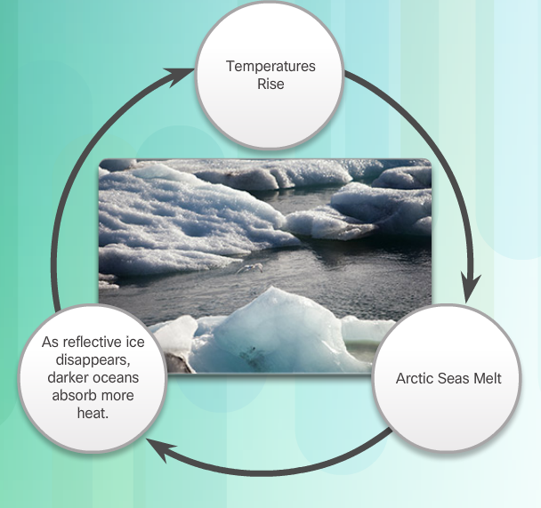
What are Things? Processes in Controlled Systems (Cont.)
Closed-Loop Controllers
There are many types of closed-loop controllers:
Proportional controllers (P): based on the difference between the measured output and the desired output.
Integral controllers (PI): use historical data to measure how long the system has deviated from the desired output.
Proportional, Integral and Derivative controllers (PID): include data about how quickly the system is approaching the desired output.
PID controller is an efficient way to implement feedback control.
The Arduino and Raspberry Pi devices can be used to implement PID controllers.
Interdependent Systems
Most systems have many interdependent pieces contributing to and affecting the output.
Notes:
1.1 - What are Things?
1.1.3 – Processes in Controlled Systems (Cont.)

Slide 12
1.2 What are Connections?
Notes:
Cisco Networking Academy Program
IoT Fundamentals Connecting Things 2.01
Chapter 1: Things and Connections
1.2 What are Connections?

Slide 13
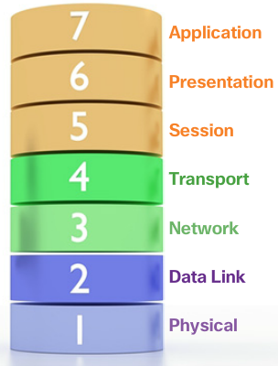
What are Connections? 1.2.1 Models of Communication
Models of Communication
Layered networking models are used to illustrate how a network operates. Benefits include:
Assists in protocol design.
Fosters competition.
Promotes technology or capability independence.
Provides a common language to describe networking functions and capabilities.
Notes:
1.2 - What are Connections?
1.2.1 – Models of Communication

Slide 14
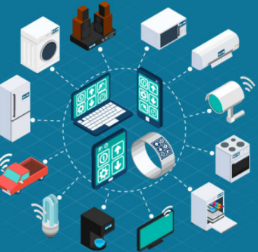
What are Connections? 1.2.1 Models of Communication (cont’d)
Standardization
The challenge for the IoT is to ensure these emerging IoT devices can connect securely and reliably to the Internet and to each other.
Consistent, secure, and commonly recognized technologies and standards is needed.
Organizations such as the Industrial Internet Consortium, OpenFog Consortium, and the Open Connectivity Foundation, are helping to develop standard architectures and frameworks.
Notes:
1.2 - What are Connections?
1.2.1 – Models of Communication

Slide 15
What are Connections? Models of Communication (Cont.)
TCP and OSI Models
Both OSI and TCP/IP models are used to describe network connections and often used interchangeably.
The TCP/IP model is commonly referred to as the Internet model.
The OSI model provides an extensive list of functions and services that can occur at each layer.
IoT World Forum Reference Model
Developed as a common framework to guide and to help accelerate IoT deployments.
It’s intent is to provide common terminology and help clarify how information flows and is processed for a unified IoT industry.
Notes:
1.2 - What are Connections?
1.2.1 – Models of Communication (Cont.)

Slide 16
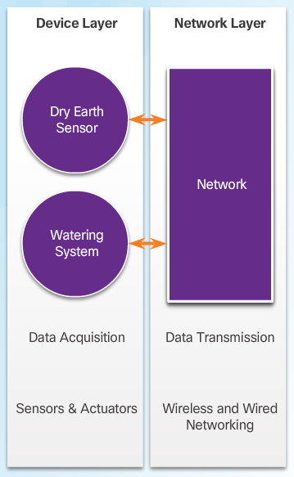
What are Connections? Models of Communication (Cont.)
Simplified IoT Architecture
Several architectures exist to help facilitate the design and creation of IoT systems.
The OSI model, TCP/IP model, and the IoT World Forum Reference model have been presented as examples.
A simpler approach is based on connection levels. The levels are:
Device-to-Device
Device-to-Cloud
Device-to-Gateway-to-Cloud
Device-to-Gateway-to-Cloud-to-Application
Notes:
1.2 - What are Connections?
1.2.1 – Models of Communication (Cont.)

Slide 17
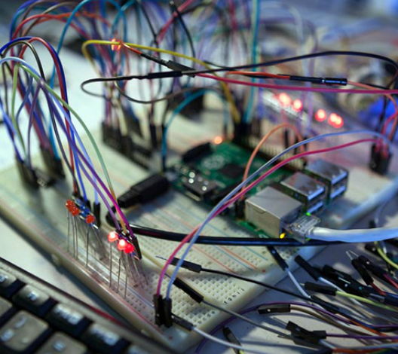
What are Connections? 1.2.2 Layers of Connections
Connections Within Networks
Connections can have different contexts.
Power connections, circuit connections or network connections.
Physical Connections
Relate to the media and cable type.
Common media types include copper, fiber optics and wireless.
Notes:
1.2 - What are Connections?
1.2.2 – Layers of Connections

Slide 18
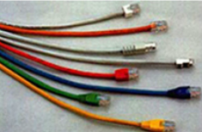
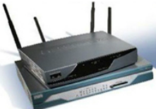
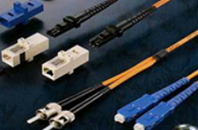
What are Connections? Layers of Connections (cont’d)
Data Link and Network Connections
Network communication requires protocols to establish the rules of communications. Data Link protocols:
Allow the upper layers to access the media
Prepare network data for the physical network
Control how data is placed and received on the media
Exchange frames between nodes over a physical network media, such as copper or fiber-optic
Receive and directing packets to an upper layer protocol
Perform error detection
The most popular data link layer connection used in wired networks is Ethernet.
Other data link protocols include wireless standards such as IEEE 802.11 (Wi-Fi), IEEE 802.15 (Bluetooth), and cellular 3G or 4G networks.
LoRaWAN and NB-IoT are examples of emerging IoT supporting technologies.
Notes:
1.2 - What are Connections?
1.2.2 – Layers of Connections

Slide 19
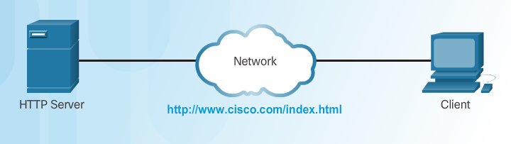
What are Connections? Layers of Connections (Cont.)
Application Connections
The IoT supports many types of connections.
Devices must use the same application layer protocols to connect.
The application will vary depending on the devices and type of connection involved.
MQTT and REST are newer application protocols, created to support IoT devices that connect in the myriad of different types of remote configurations.
MQTT is a lightweight messaging protocol with minimal overhead that provides high data integrity and security for remote environments.
REST or RESTful web services is a type of API designed to make it easier for programs to interact over the Internet.
Notes:
1.2 - What are Connections?
1.2.2 – Layers of Connections (Cont.)

Slide 20
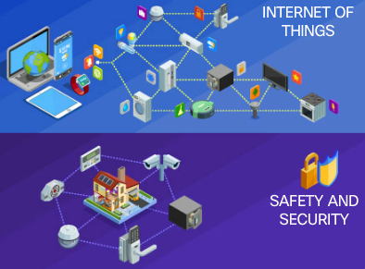
What are Connections? 1.2.3 Impact of Connections on Privacy and Security
What is Metadata?
Metadata refers to the data about data.
Metadata can be embedded within a digital object or it can be stored separately.
Metadata is not usually seen by a user.
The Impact of IoT on Privacy
Suggestions and design considerations concerning privacy include:
Transparency
Data Collection and Use
Data Access
Challenges for Securing IoT Devices
Some IoT network security impacting factors include:
Increasing Number of Devices
Non-Traditional Location of Devices
Changing Type and Quantity of Gathered Data
Lack of Upgradeability
Notes:
1.2 - What are Connections?
1.2.3 – Impact of Connections on Privacy and Security

Slide 21
1.3 Chapter Summary
Notes:
Cisco Networking Academy Program
IoT Fundamentals Connecting Things 2.01
Chapter 1: Things and Connections

Slide 22
Chapter Summary Summary
The Internet of Things (IoT) is all around us. An IoT system is usually made up of sensors to monitor events, actuators to influence the environment, hardware to create the platform and its connections, and software to provide a framework to execute processes.
A process is a series of steps or actions taken to achieve a desired result.
Layered networking models are used to illustrate and model how devices communicate. Physical, data link, and network layers are concepts that are used to illustrate how network communication operates.
Security and privacy issues must be considered in all phases of creation of an IoT system. Each level of connectivity brings with it different requirements and concerns..
Notes:
1.3.1.1 - Summary

Slide 23


Slide 24


